Slide 1
TEACHING AND LEARNING BASED ON NEUROSCIENCE
DR ABD RAZAK ZAKARIA
EDUCATIONAL FOUNDATIONS AND HUMANITIES
FACULTY OF EDUCATION, UNIVERSITY OF MALAYA
MALAYSIA

Slide 2
Neuroscience (or neurobiology) is the scientific study of the nervous system. It combines physiology, anatomy, molecular biology, developmental biology, cytology, mathematical modeling, and psychology to understand the fundamental and emergent properties of neurons and neural circuits. The understanding of the biological basis of learning, memory, behavior, perception, and consciousness has been described by Eric Kandel as the "ultimate challenge" of the biological sciences.
The scope of neuroscience has broadened over time to include different approaches used to study the nervous system at different scales and the techniques used by neuroscientists have expanded enormously, from molecular and cellular studies of individual neurons to imaging of sensory, motor and cognitive tasks in the brain.

Slide 3
Physiology from Ancient Greek(physis) 'nature, origin', and -λογία (-logia) 'study ofis the scientific study of functions and mechanisms in a living system. As a sub-discipline of biology, physiology focuses on how organisms, organ systems, individual organs, cells, and biomolecules carry out the chemical and physical functions in a living system
Anatomy is the branch of biology concerned with the study of the structure of organisms and their parts. Anatomy is a branch of natural science which deals with the structural organization of living things
Molecular biology is the branch of biology that concerns the molecular basis of biological activity in and between cells, including molecular synthesis, modification, mechanisms and interactions
Developmental biology is the study of the process by which animals and plants grow and develop. Developmental biology also encompasses the biology of regeneration, asexual reproduction, metamorphosis, and the growth and differentiation of stem cells in the adult organism.

Slide 4
cytology is a branch of biology studying the structure and function of the cell, also known as the basic unit of life.
A mathematical model is a description of a system using mathematical concepts and language.
Psychology is the science of mind and behavior. Psychology includes the study of conscious and unconscious phenomena, as well as feeling and thought.
A neuron or nerve cell is an electrically excitable cell[1] that communicates with other cells via specialized connections called synapses. It is the main component of nervous tissue in all animals

Slide 5
A neural circuit is a population of neurons interconnected by synapses to carry out a specific function when activated.
Learning is the process of acquiring new understanding, knowledge, behaviors, skills, values, attitudes, and preferences.
Memory is the faculty of the brain by which data or information is encoded, stored, and retrieved when needed. It is the retention of information over time for the purpose of influencing future action.
Behavior is the actions and mannerisms made by individuals, organisms, systems or artificial entities in conjunction with themselves or their environment, which includes the other systems or organisms around as well as the (inanimate) physical environment.
Perception (from the Latin perceptio, meaning gathering or receiving) is the organization, identification, and interpretation of sensory information in order to represent and understand the presented information or environment

Slide 6
Consciousness at its simplest is "sentience or awareness of internal or external existence.
Sensory neurons, also known as afferent neurons, are neurons in the nervous system, that convert a specific type of stimulus, via their receptors, into action potentials or graded potentials.
A motor neuron (or motoneuron) is a neuron whose cell body is located in the motor cortex, brainstem or the spinal cord, and whose axon (fiber) projects to the spinal cord or outside of the spinal cord to directly or indirectly control effector organs, mainly muscles and glands
Cognition refers to "the mental action or process of acquiring knowledge and understanding through thought, experience, and the senses

Slide 7

Teaching and learning in Malaysian context

Slide 8
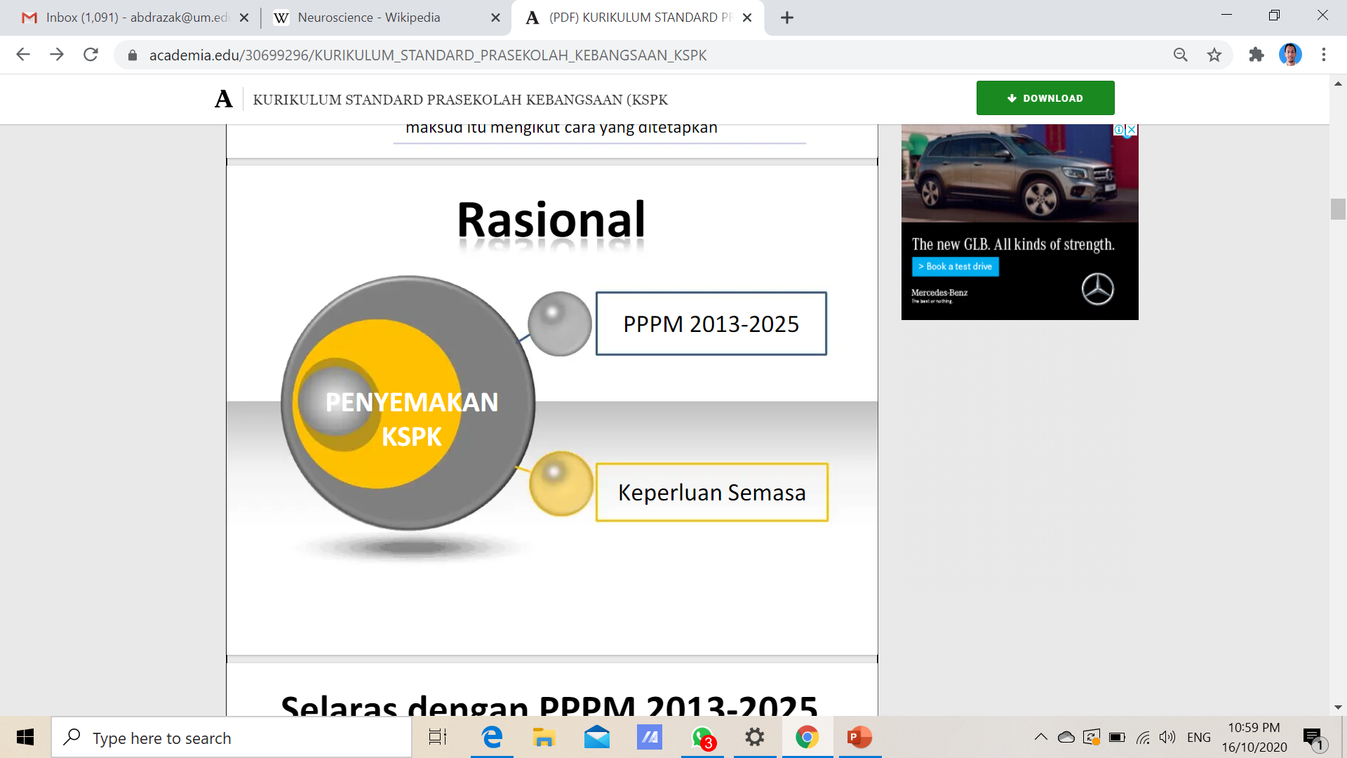

Slide 9


Slide 10
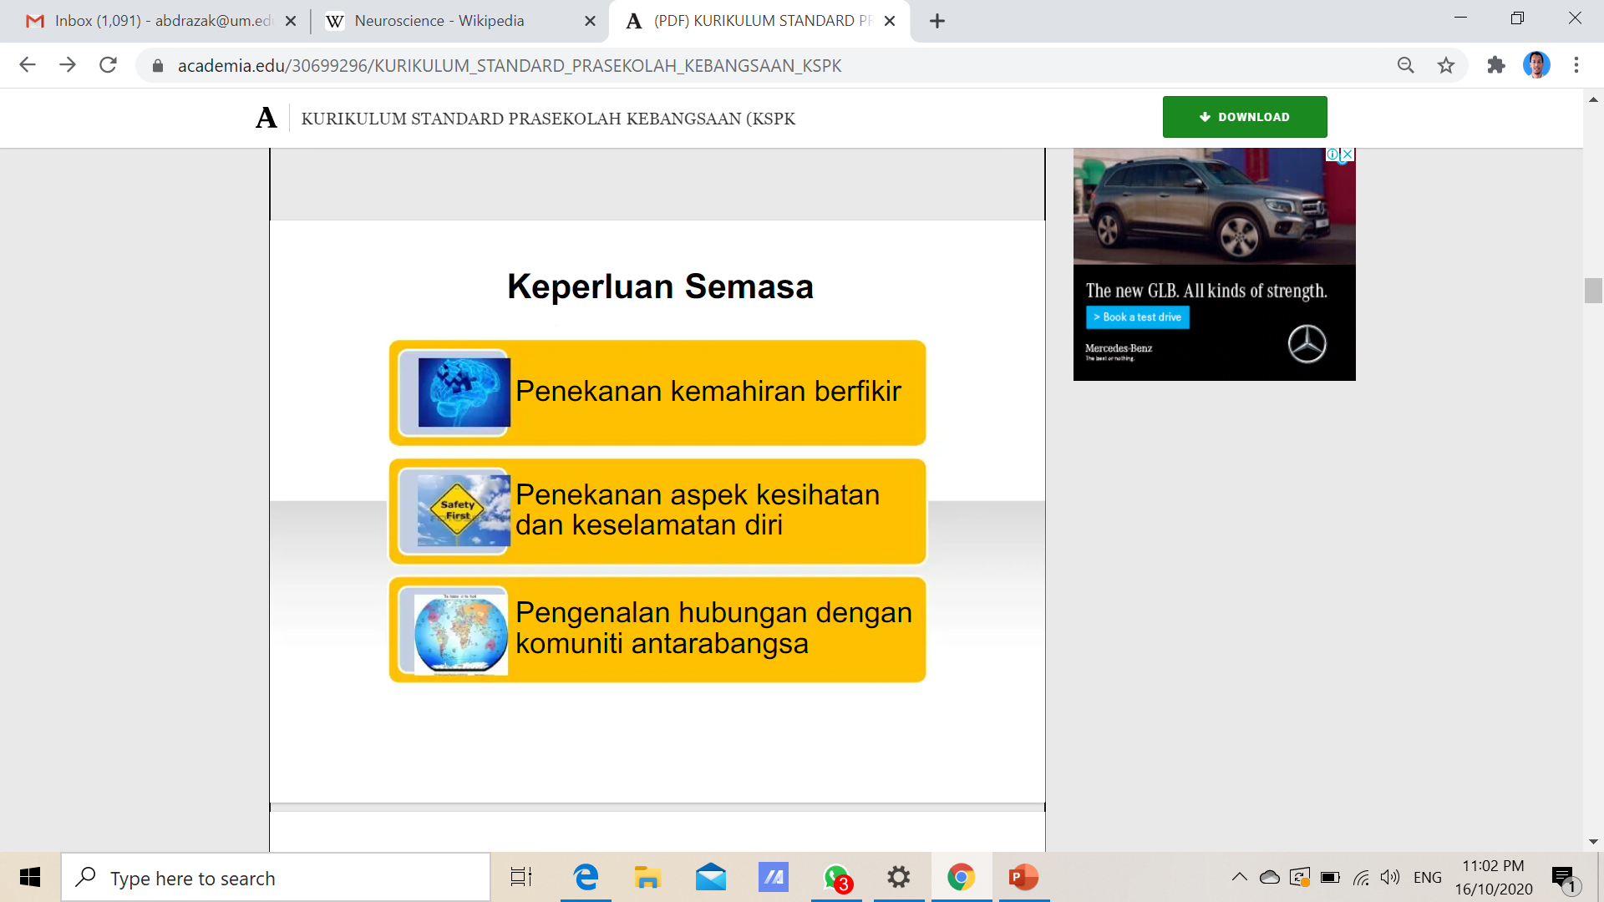

Slide 11
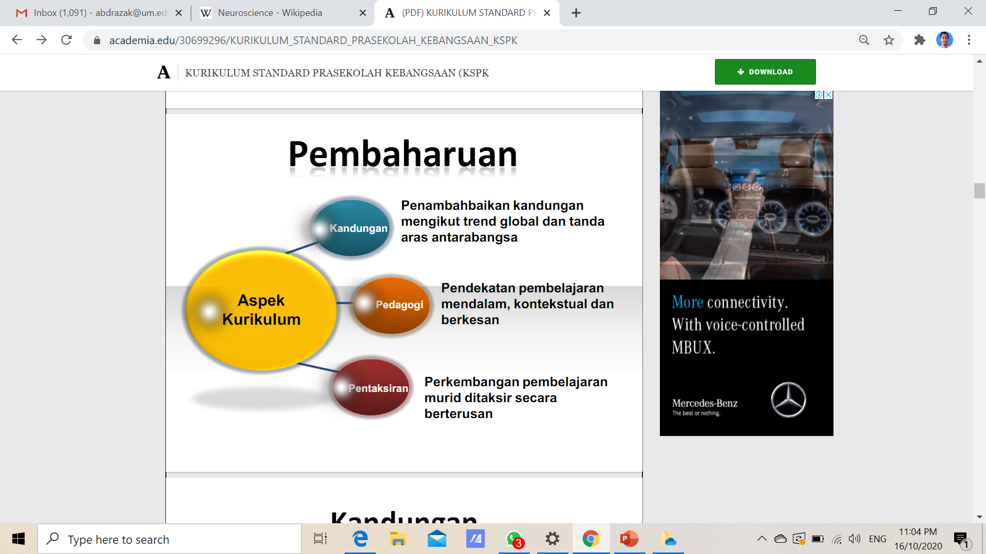

Slide 12


Slide 13


Slide 14


Slide 15
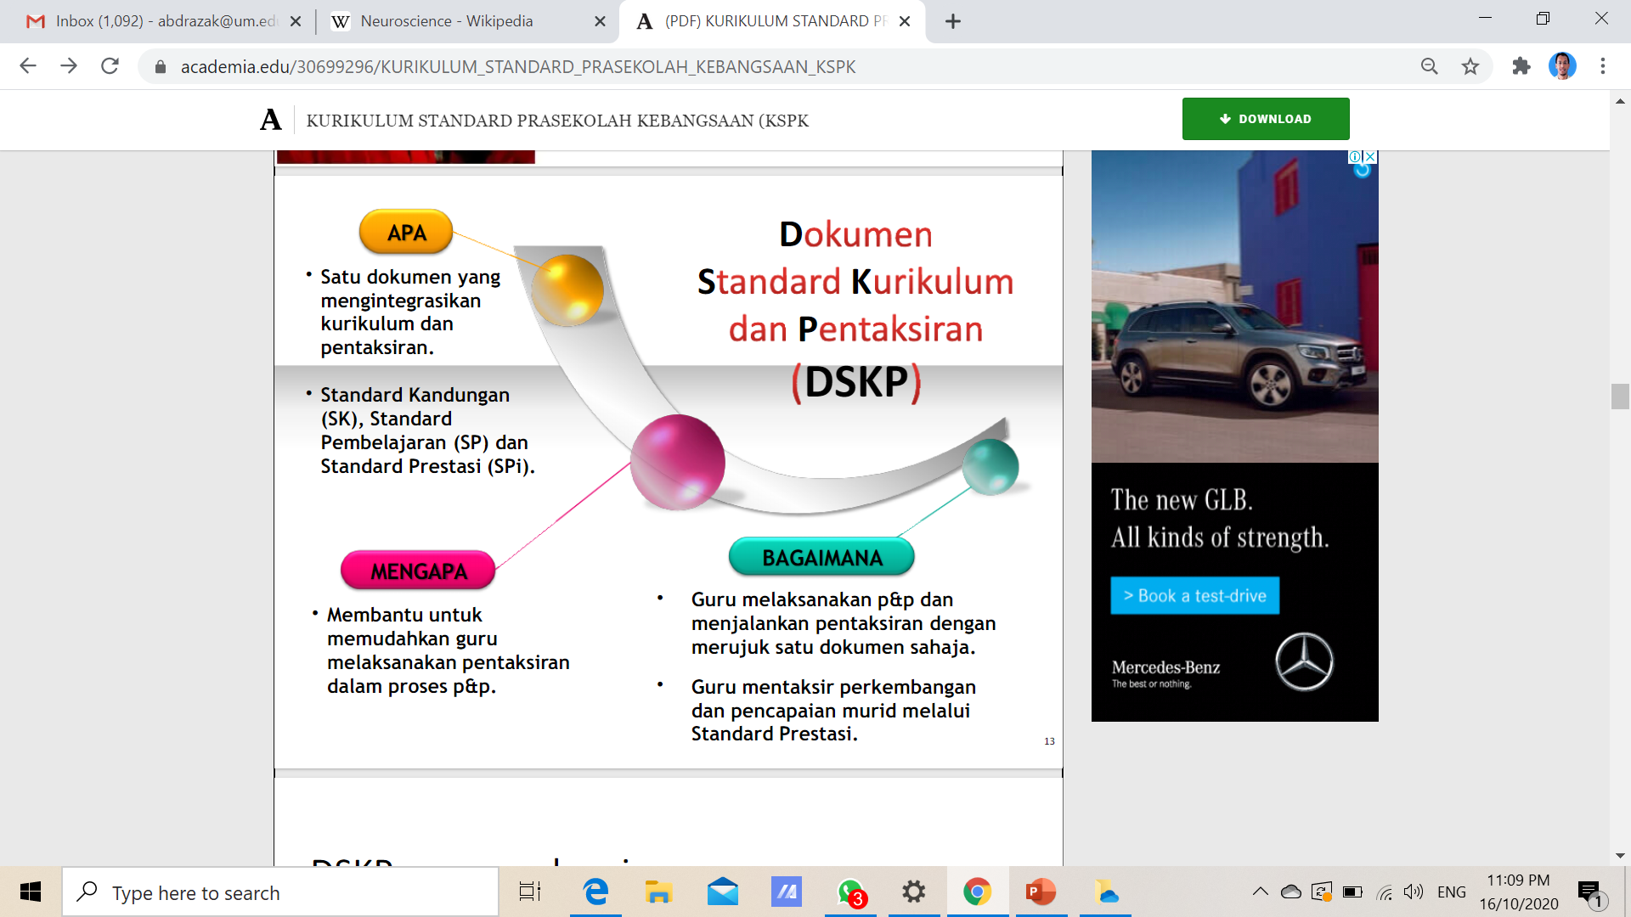

Slide 16
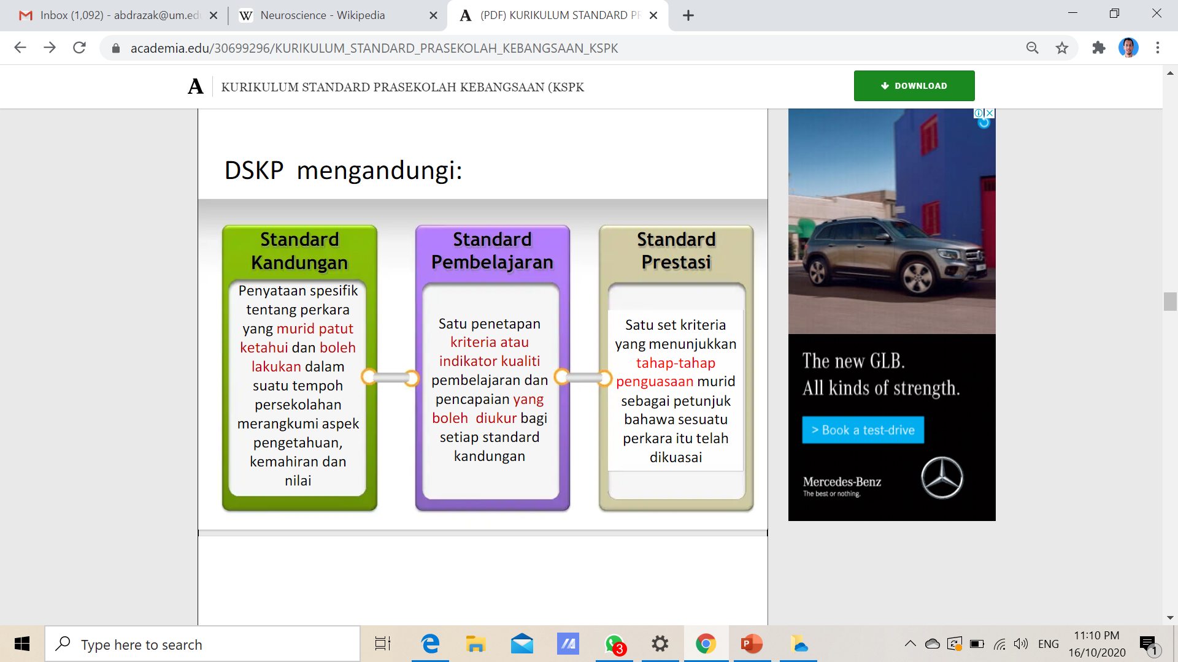

Slide 17
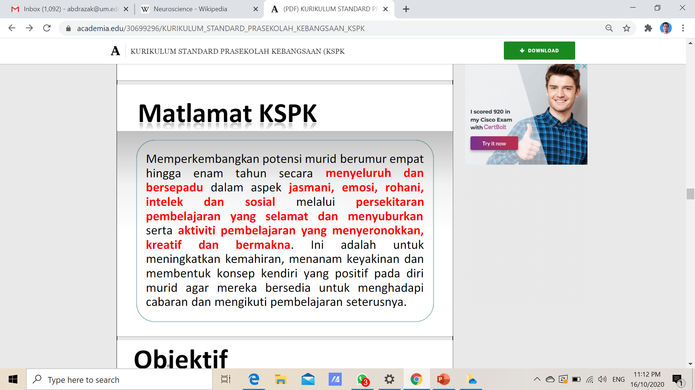

Slide 18


Slide 19
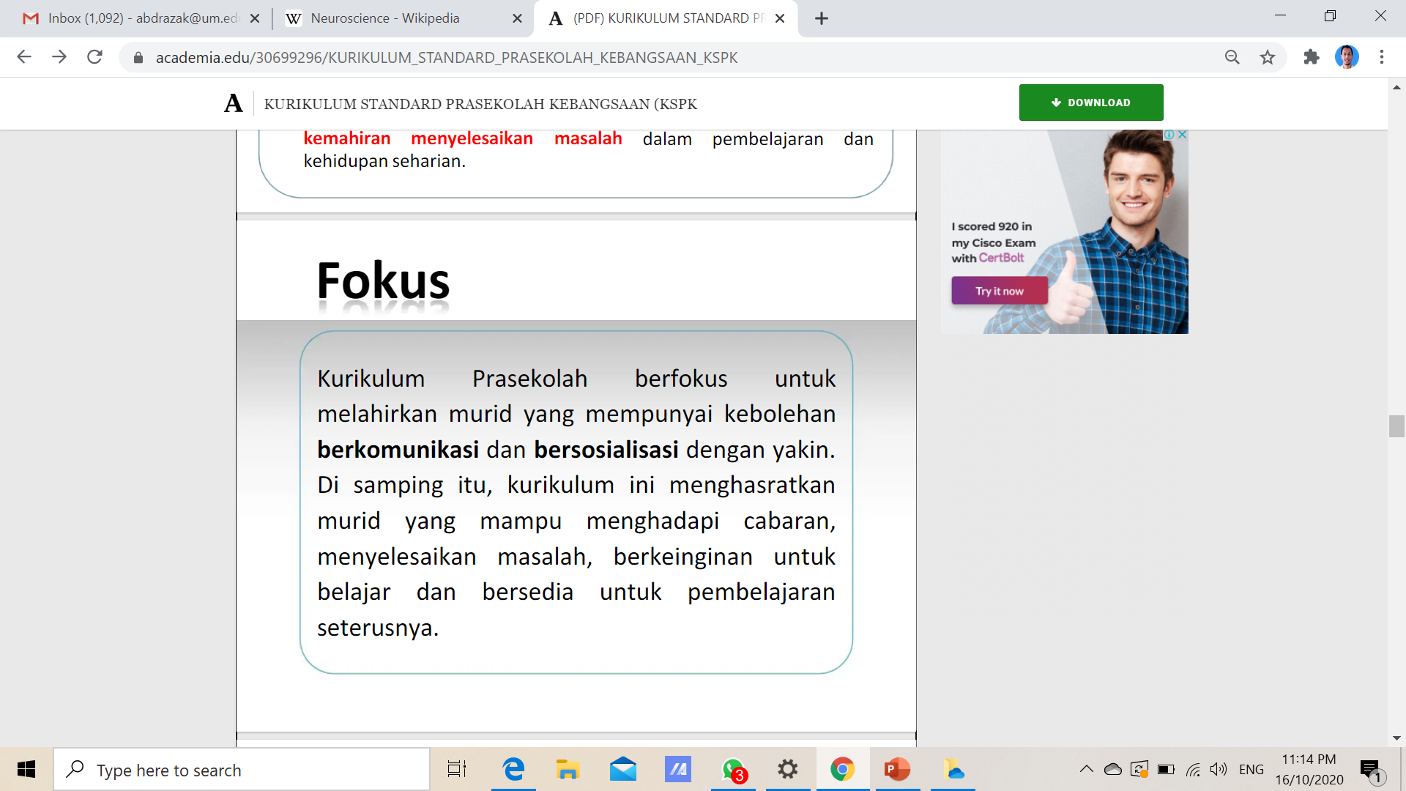

Slide 20
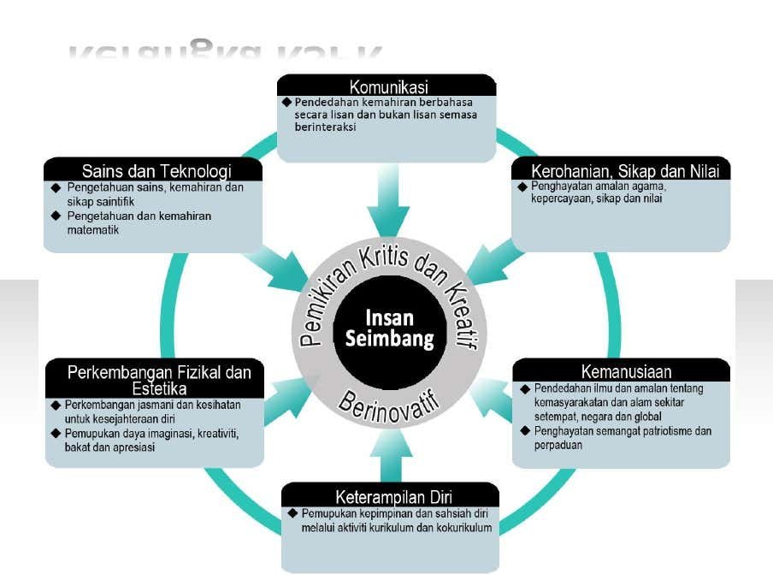

Slide 21
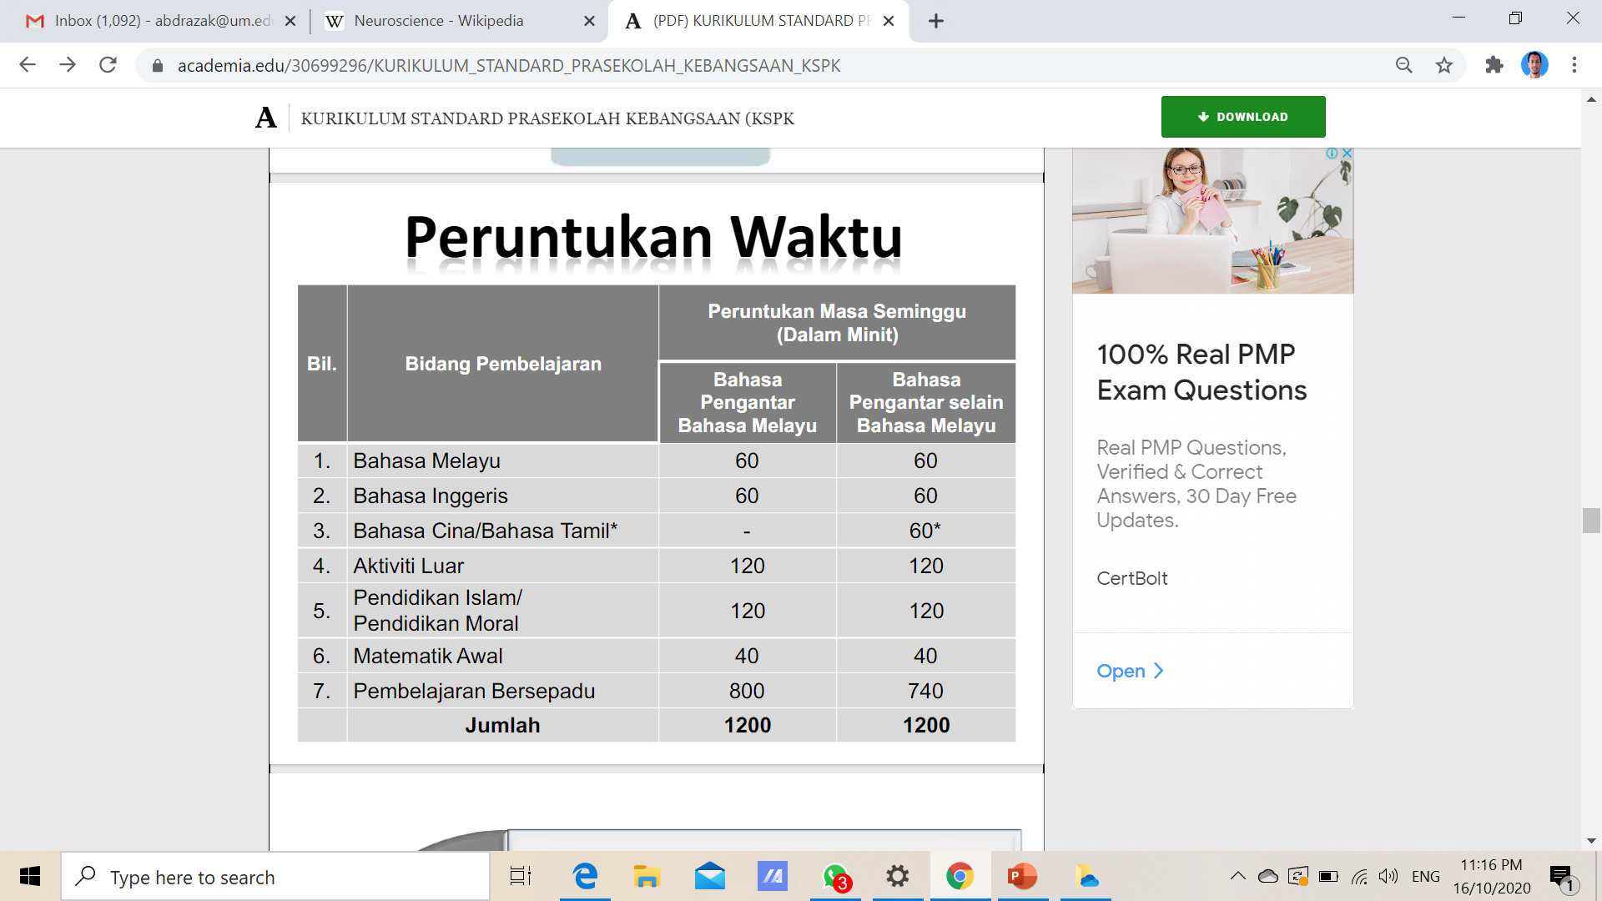

Slide 22
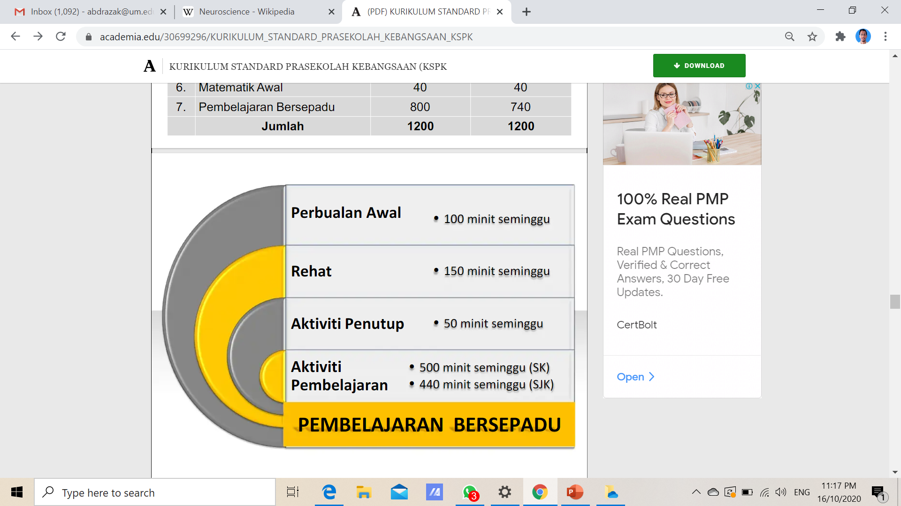

Slide 23


Slide 24


Slide 25
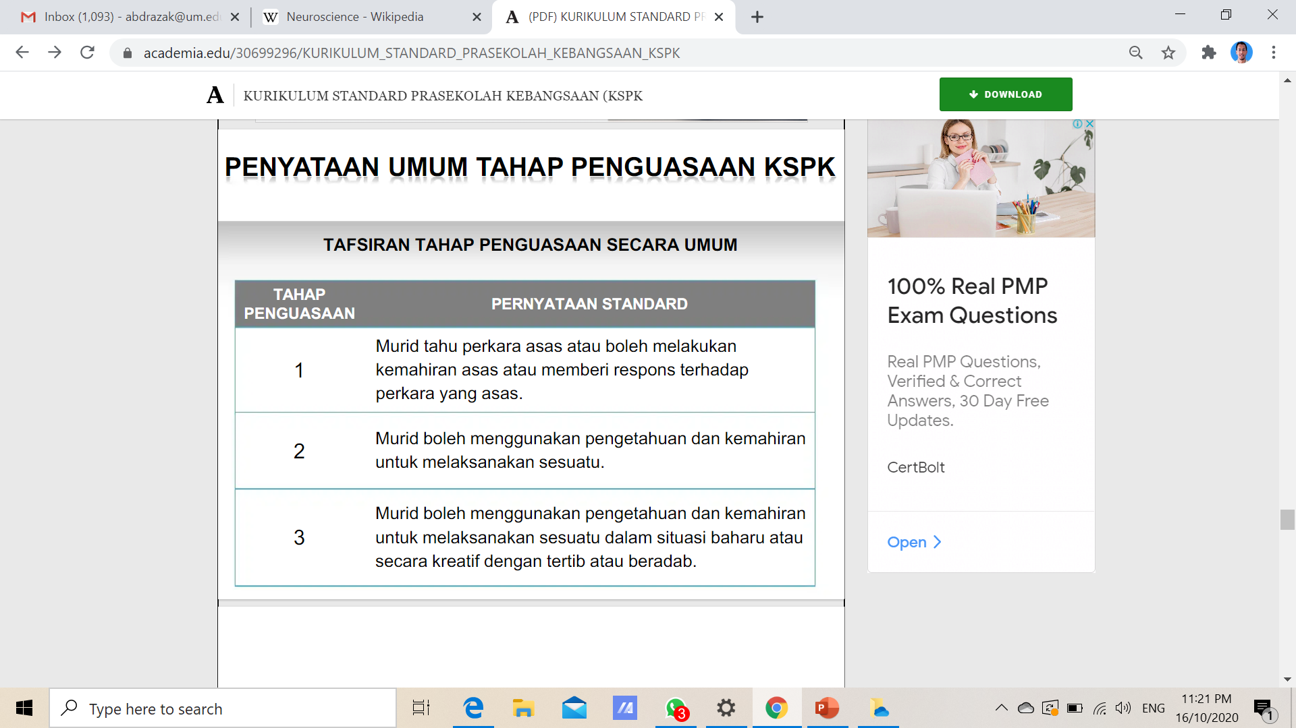

Slide 26
SEKIAN
TERIMA KASIH

